Slide 1
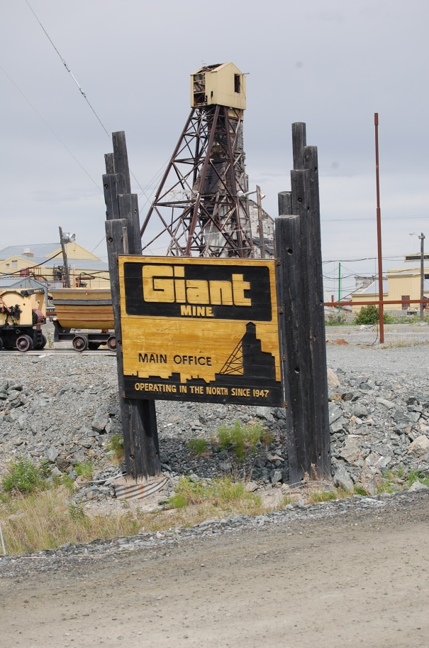
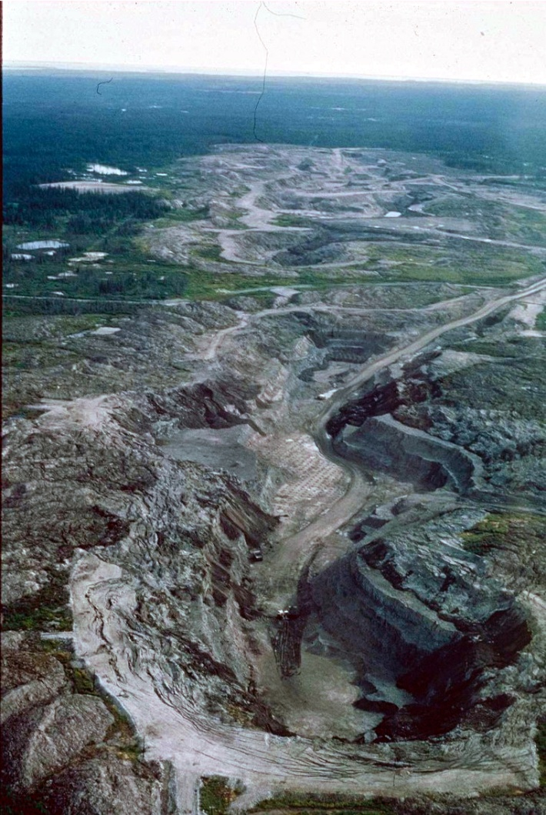
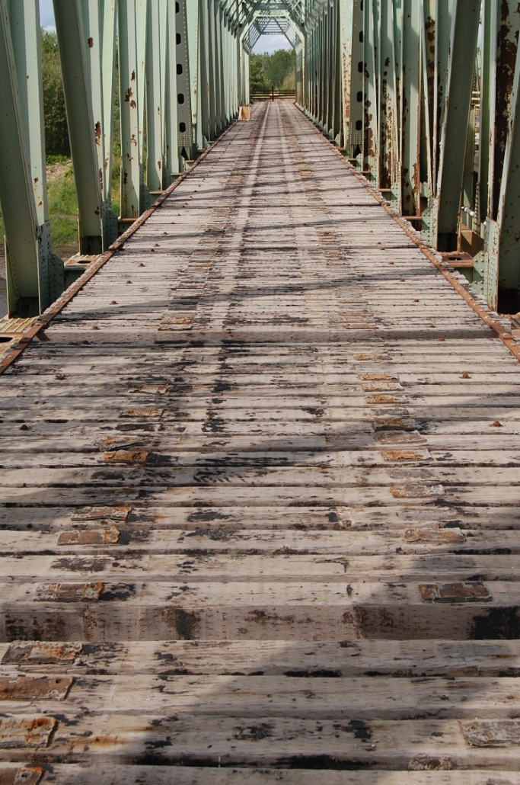
Ghost Towns and Zombie Mines:
The Future History of Mining in Canada
Arn Keeling, Department of Geography
Geography Awareness Week 2013

Slide 2
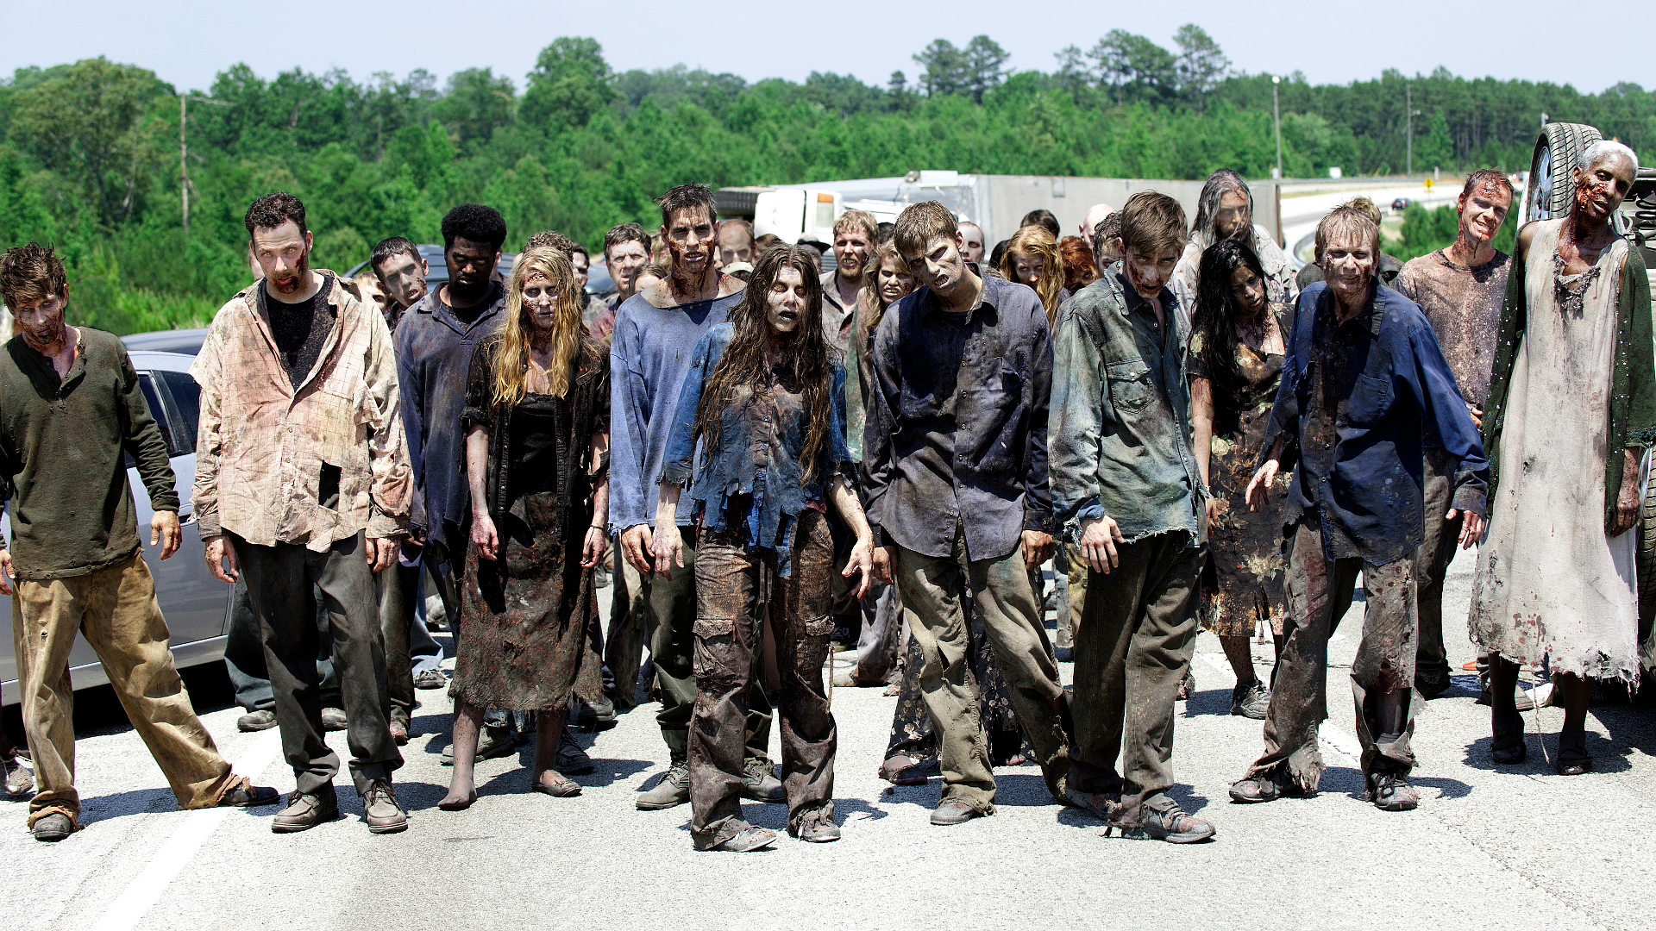
Zombies…. (with the brain-eating, rotting faces, etc.)

Slide 3
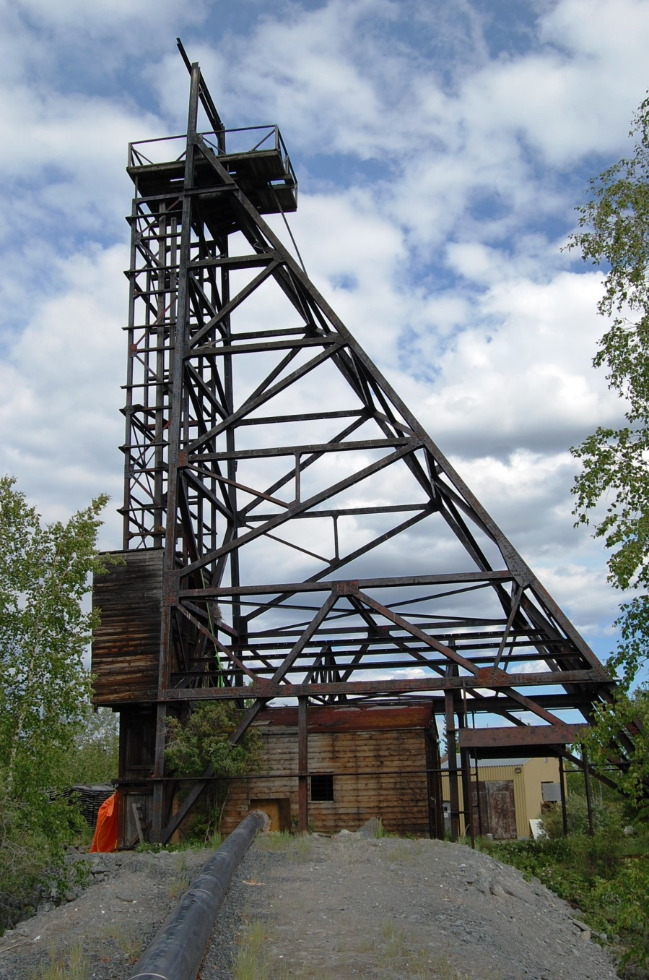
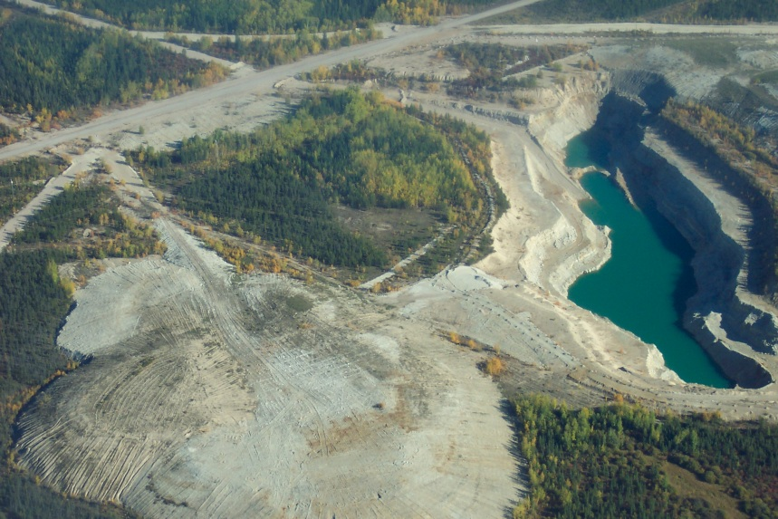
…and mines??
(with the minerals and wealth that support our industrial economies.)

Slide 4
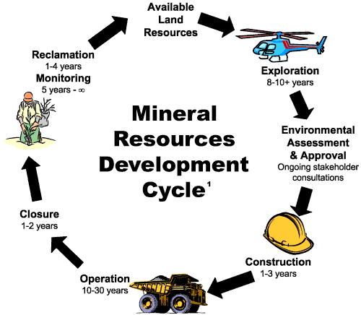
Beyond the ‘mining cycle’: Zombies
Aschmann (1970)
zombie mine: a site formerly closed/abandoned by its owner as uneconomic or exhausted, then later reanimated under new ownership and different circumstances; or, a mine exerting some sort of beyond-the-grave effect on people or the environment

Slide 5
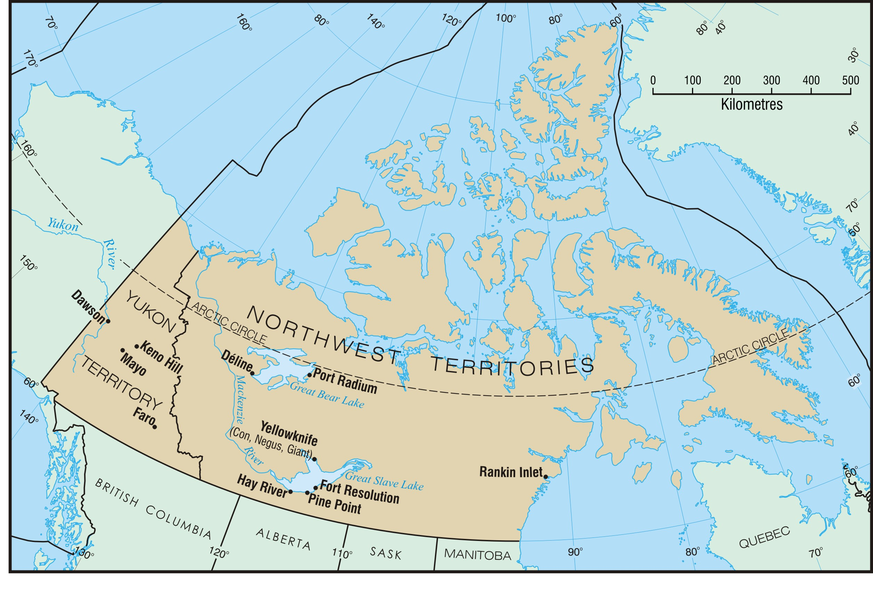
Map by Charlie Conway
Notes:
case studies: particular focus today on Pine Point

Slide 6
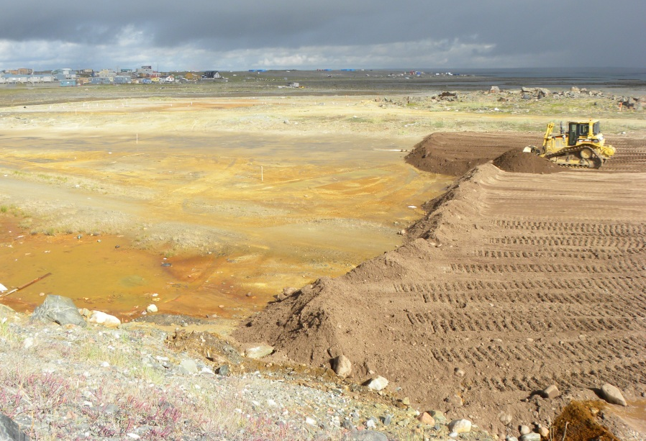
Zombie mines in Northern Canada
federal or territorial governments currently overseeing remediation, assessment and/or monitoring activities at 16 contaminated mine sites in NU, YK and NWT
private companies re-developing at least six mines; four of these sites simultaneously undergoing remediation
Recapping tailings area, Rankin Inlet, NU—author
Road to Bellekeno Mine (Keno, YK)—A. Winton

Slide 7
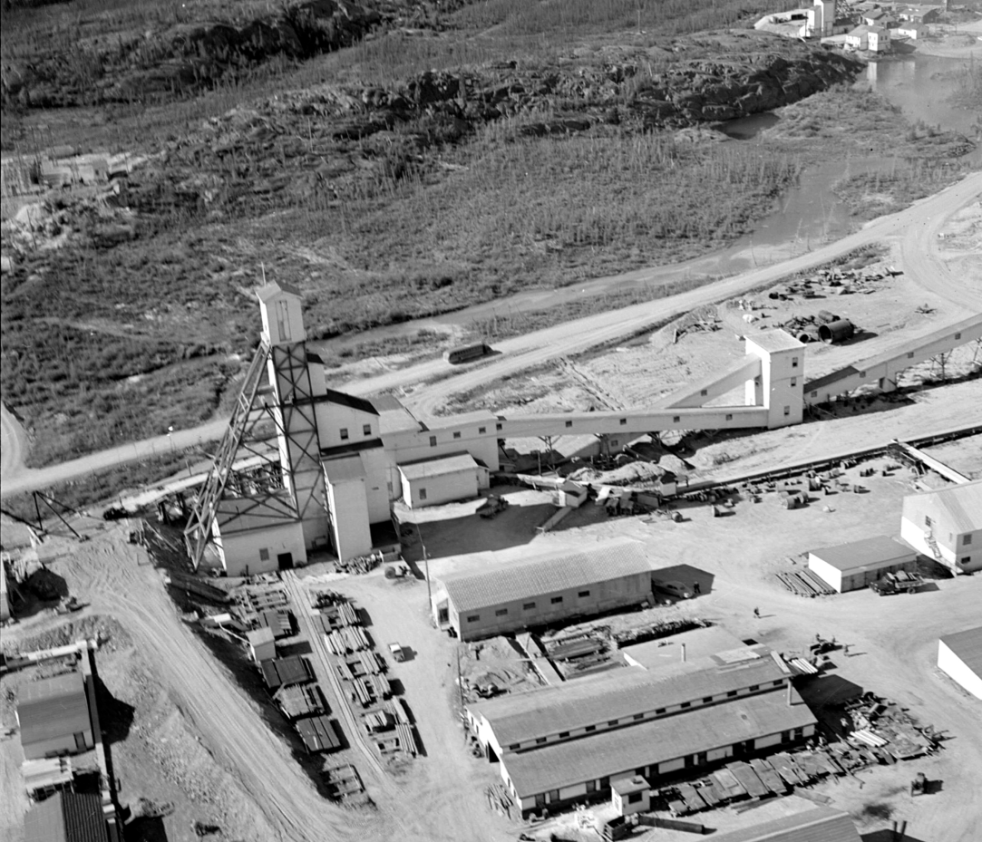
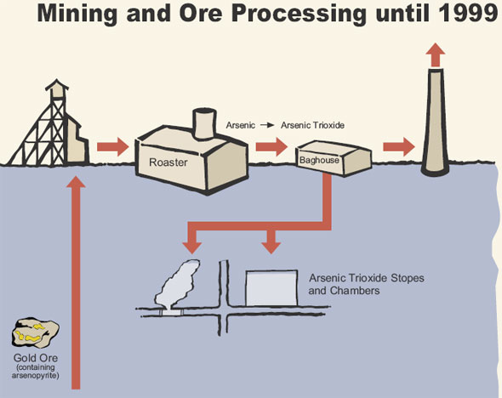
Giant Mine: Toxic zombie
major gold producer, 1948-2004
also, major pollution: arsenic trioxide emissions from smelting
1949-51 – Airborne arsenic emissions at 7500 kg/day
1951: death of Dene boy, cattle on Bevan farm
techno-fix: Cottrell Electro-static Precipitator (1951, 53)
collection and underground storage of As until 1999
bankruptcy of company

Slide 8
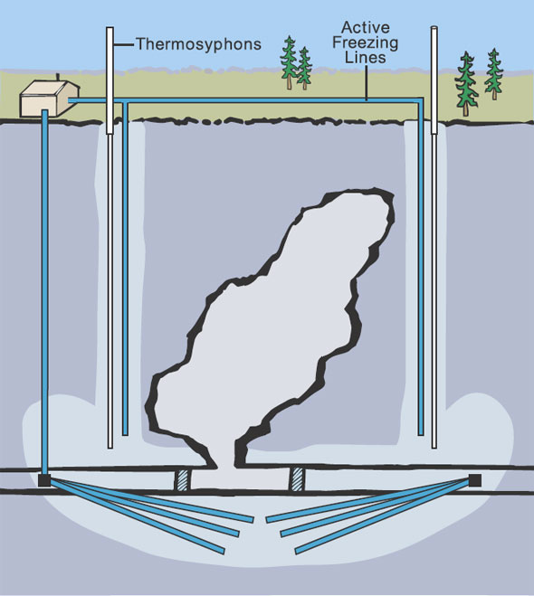
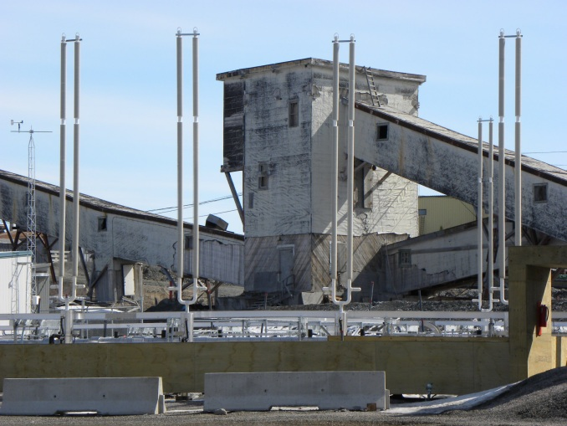
Giant Mine: Toxic Zombie
INAC assumes control, launches reclamation plan 2005
main problem: 237,000 tonnes of arsenic trioxide dust underground
proposed solution: frozen block method (in situ stabilization)
environmental assessment, public hearings (2012)
legacy costs borne by public ($1bn, estimated)
problem of ‘perpetual care’ and monitoring
Test thermosyphons at Giant Mine site—author photo

Slide 9
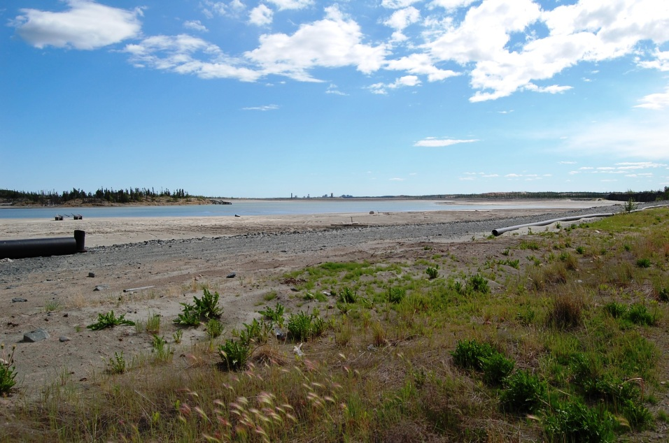
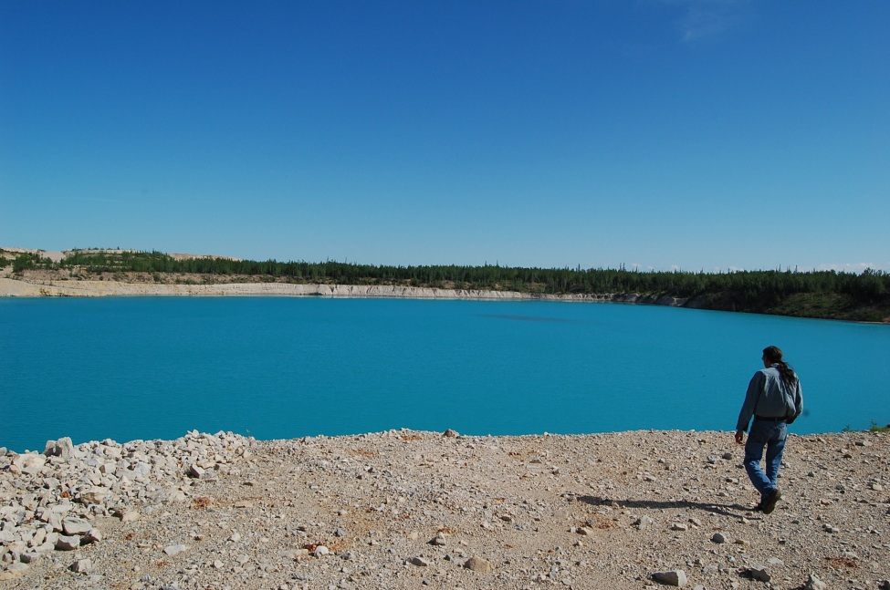
Implications of zombie mines
reawakening or reproduction of historical injustices associated with past developments
conflict over who bears costs and consequences of environmental legacies (usually the public, local people)
illustrate the ‘afterlife’ of mining—the long-term consequences of resource development
Main tailings area, Giant Mine—author
Pit lake, Pine Point Mine—author

Slide 10
Find out more at:
www.abandonedminesnc.com
Research funded by Social Sciences and Humanities Research Council of Canada, Social Economy Research Network of Northern Canada, ArcticNet, and Memorial University
Contact:
Dr. Arn Keeling
Department of Geography
Memorial University
akeeling@mun.ca
Akaitcho shaft, Giant Mine, Yellowknife—author

